Slide 1
Workshop KES
Save time for writing a nice report!
Internal use only
Dennis van Kan en Anouk Hick
6 september 2022

Slide 2
Workshop KES
What is KES?
Introduction to KES
Royal HaskoningDHV Insight - Kes (corporateroot.net)

Slide 3
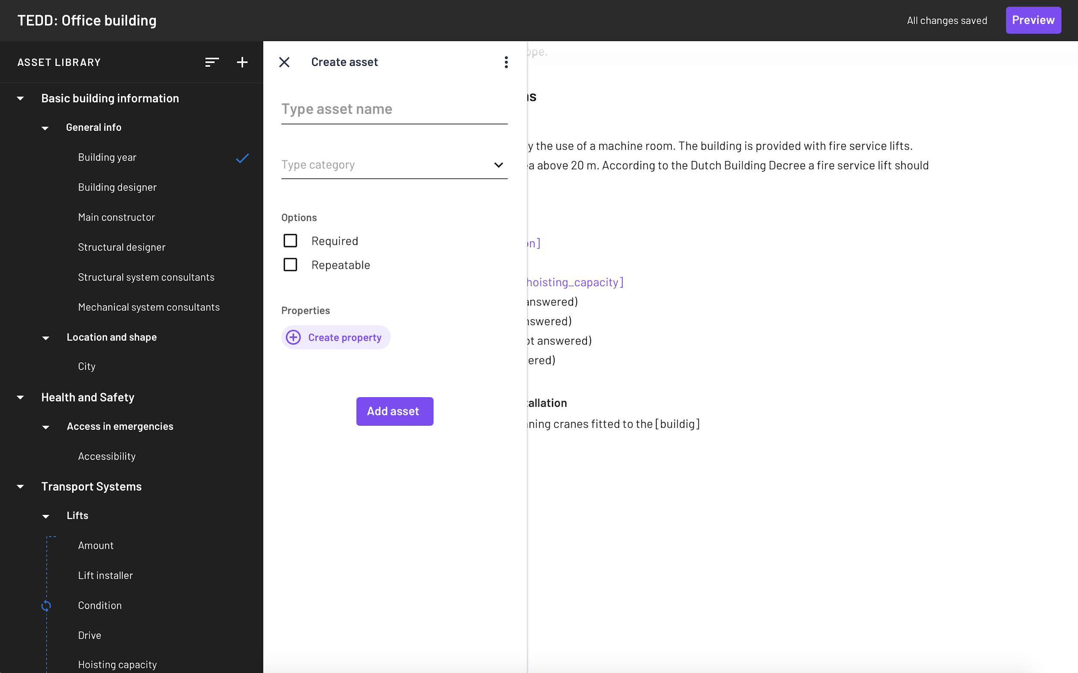

What is KES?
KES: Knowledge Expert System
KES functions:
  Captures domain knowledge
  Standardizes domain knowledge
  Automates domain knowledge

Slide 4
Benefits KES
Save and share knowledges
Build report templates
Create studies
Collaborate
Speed up the work process of your colleagues
Deliver a quality report to the client

Slide 5
How it works
1
Expert creates assets and properties library
2
Expert creates report template
3
System generates a questionnaire
4
Questionnaire is answered during a study
5
System automatically generates a report
Continue adding the report in Word like you're used to

Slide 6
Developments
Run Python script (available)
Word Add-in (create a template in Word)
iReport integration
Briefbuilder intergration
  https://www.briefbuilder.com

